Slide 1
Intro to CSS
CS/IT 490 WD, Fall 2013

Slide 2
Breakdown
What is CSS?
Firebug / Chrome Inspect
Where you can write CSS
Corresponding elements to styles
Inheriting styles
Specificity
Overriding styles

Slide 3
What is CSS?
CSS stands for Cascading Style Sheets.
A means for keeping page structure (HTML) separate from style (CSS).
Allows you to style webpage elements based on type of element, class of element, or id of element.

Slide 4
Firebug / Chrome Inspect
Make sure to download Firebug for Firefox if that is your primary browser.
Google Chrome's inspect element tool is pretty similar.
Remember that Safari lets you change the user agent (i.e., to test for ios devices)

Slide 5
Where you can write CSS
You can add CSS styling into one individual element.
You can add CSS rules within one specific webpage file.
You can add CSS rules into an external .css file and link it to multiple webpages.
  This is the best way to work with CSS.

Slide 6
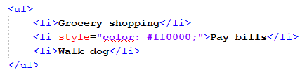
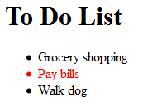
Where you can write CSS
Styling an individual element (inline)
  Might be useful for letting people style their blog-posts; it's a one-time style that doesn't need to be applied to other areas of the webpage.

Slide 7
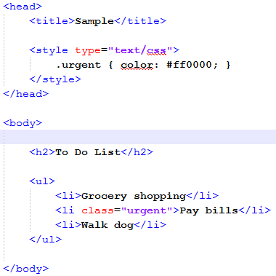
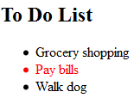
Where you can write CSS
Adding rules in the .html page
  If you wanted common styles across multiple pages, this wouldn't work well.
Css rule for class 'urgent'
Element given special class

Slide 8
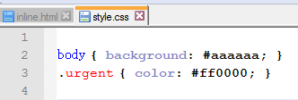
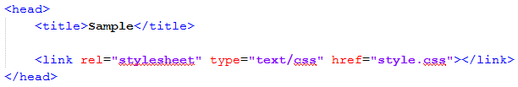
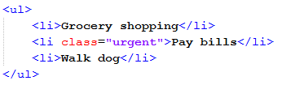
Where you can write CSS
Adding rules in .css file
  You can add rules in a .css file and link to them in the .html file.
Creating styles
Linking the .css file into the .html file
Using classes

Slide 9
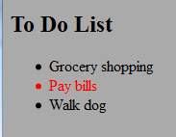
Where you can write CSS
Adding rules in .css file
  You can add rules in a .css file and link to them in the .html file.

Slide 10
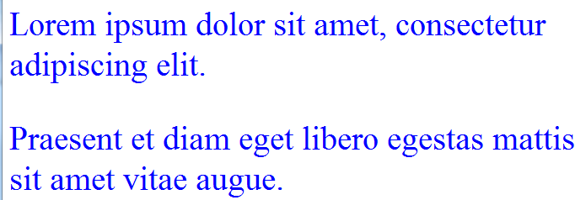
Corresponding elements to styles
You can style an element in three ways:
  Style all of a type of element - Just use the element name

Slide 11
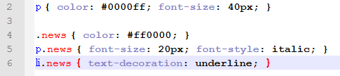
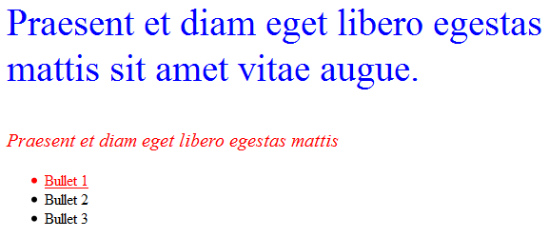
Corresponding elements to styles
You can style an element in three ways:
Style all items that belong to a class

Slide 12
Corresponding elements to styles
You can style an element in three ways:
Style all items that belong to a class
Notice that the class name goes after a period “.”
You can also combine elementType.className to make a style only apply to certain elements of that class type.

Slide 13
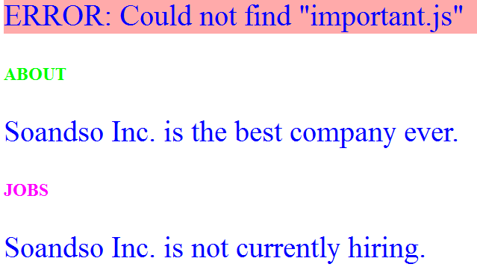
Corresponding elements to styles
You can style an element in three ways:
Style one specific element, with a specific ID
To specify ID, use the # hashtag/pound-sign. These correspond to the id attribute of an element

Slide 14

Inheriting styles
Styles can also be inherited. If you set up a style for <p>
Then set up a style for p.news (elements of type p whose class is news)
Then it inherits styles from both. If two styles clash, the one belonging to the more specific rules wins out.
News paragraph inherits the italics from its parent, but its color is overridden by the p.news style.

Slide 15

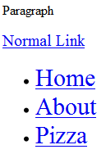
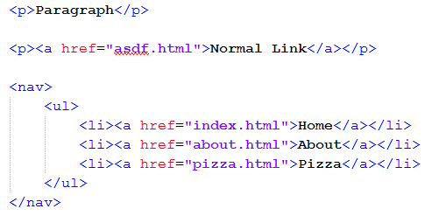
Specificity
Rules can be overridden in CSS. Whichever rule is more specific wins out.

Slide 16
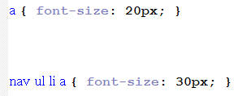

Specificity
Rules can be overridden in CSS. Whichever rule is more specific wins out.
You can force adherence with !important, but it is not good practice.
All links
Links contained within an Unordered List within a Nav

Slide 17



Overriding styles
Many elements have default styles. You can override these.

Slide 18
Summary
Style an element:
h2 { font-size: 30px; }
Style a class:
p.news { font-style: italic; }
nav .link { color: #ff0000; }
Style an id:
#header-about { background: #000000; }
ul#main-list li { list-style-type: none; }

Slide 19
References
-

